Slide 1
Amadeus
An App for Musicians
Critical Design Review
Team 7
Ryuichi Ohhata, Dev Bhatia, James Wasson, Samantha Au, Brandon DeSiata

Slide 2
01
Overview

Slide 3
Proposed Solution
Connect Local Musicians
Showcase Videos
Genre
Instrument
Skill Level
Location
Display Local Shows
Bands + Individuals can enter details of local gigs
Specify genre / setlist
People can follow bands, receive notifications of their shows

Slide 4
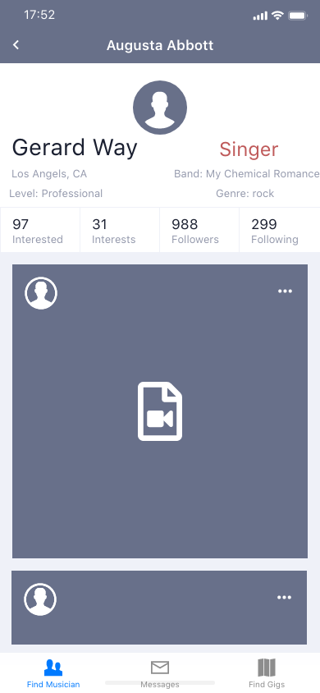
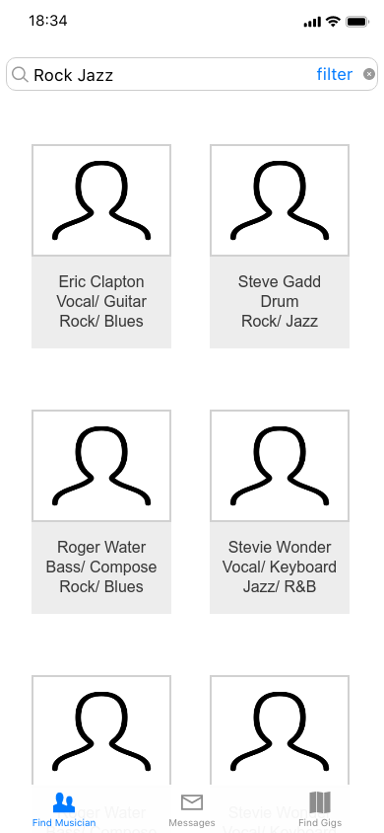
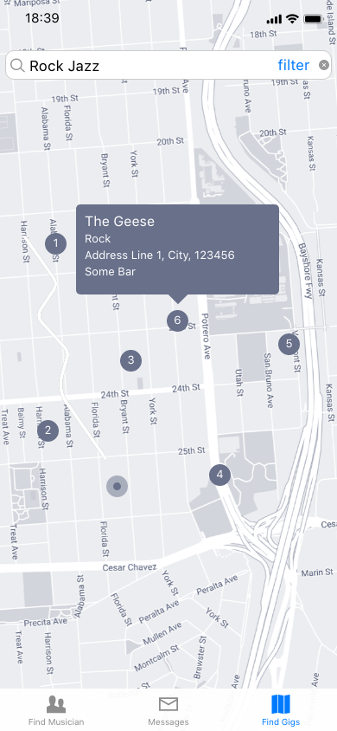
Visualization - Original UI

Slide 5
Key Requirements
Streamlined Design - The app must be easily used by a wide range (>80%) of users. The general workflow must be transparent, and adhere to the Apple AppStore technical specifications
Reliable and Efficient Communication - Messaging should happen with very infrequent erros (<1% Do Not Send), and deliver relatively quickly (< 30 seconds with strong network)
Accurate Location Data - The location data must be able to pinpoint an exact location (address) on the generated map (+/- 0.5 miles)
Secure Backend - Our application should securely user credentials and data, subject to pen-tests

Slide 6
Summary of Completed Work
Data Architecture (i.e. Backend) - Available data is able to be integrated into every feature
Messaging System - Messaging between distinct users and creating new chats
Fully Functional FE - The frontend works as expected
Map/Gig Creation - Create data to appear on the live map
Tethered Frontend/Backend - Data transfer between the db and frontend

Slide 7
02
Updated Architecture

Slide 8
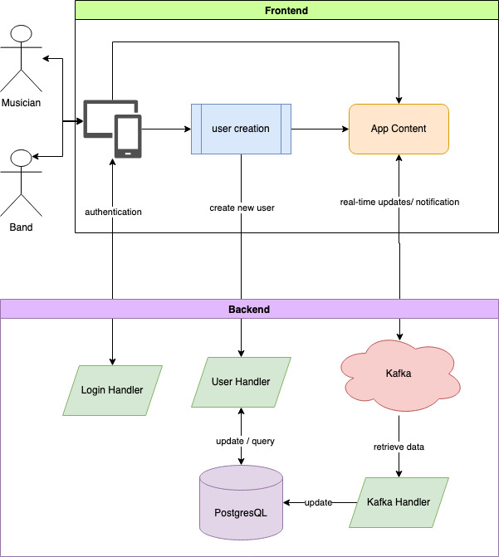
Overall System

Slide 9
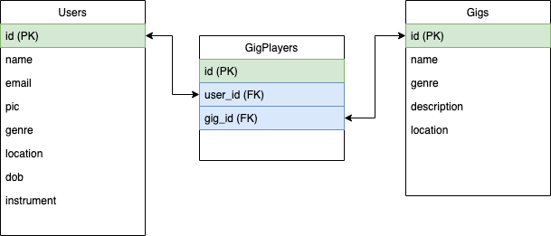
Database Tables

Slide 10
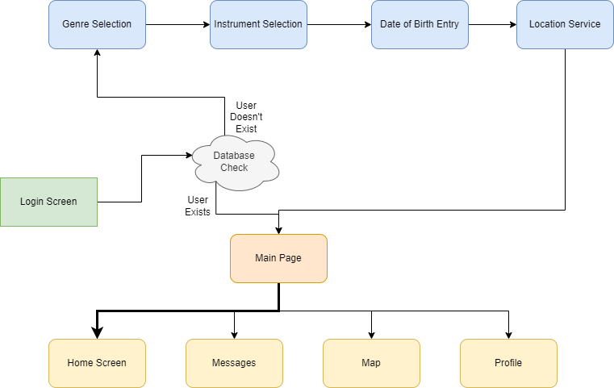
Current Screenflow

Slide 11
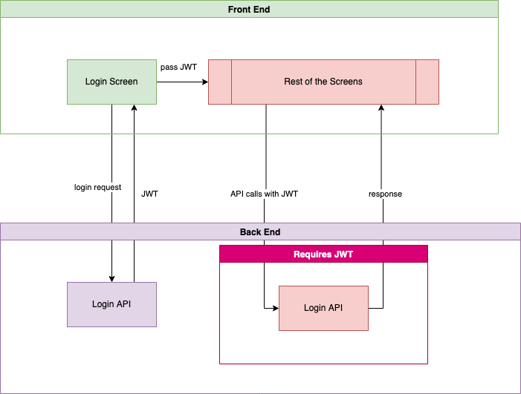
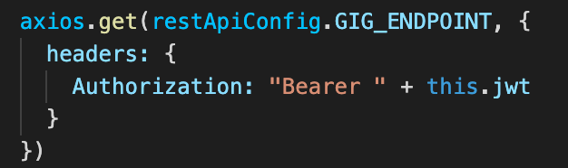
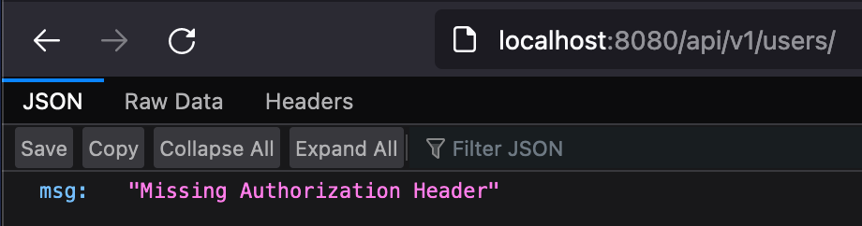
Security: JSON Web Token Screenflow

Slide 12
03
Technical Progress

Slide 13
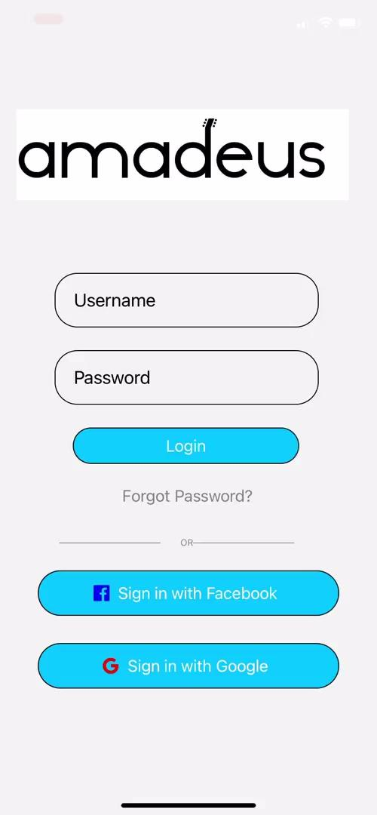
Video

Slide 14
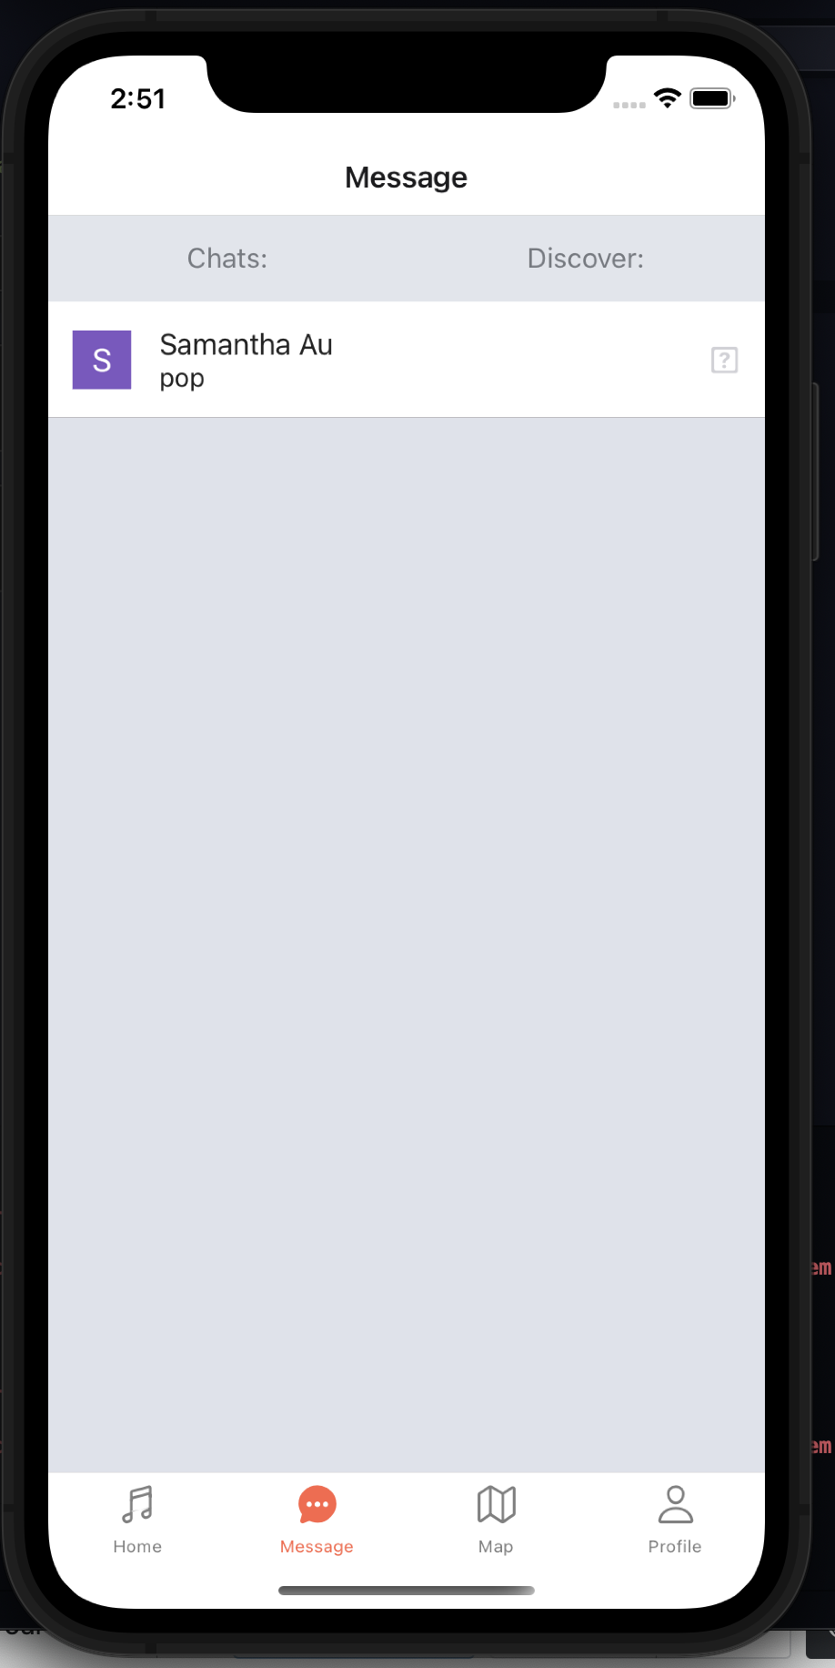
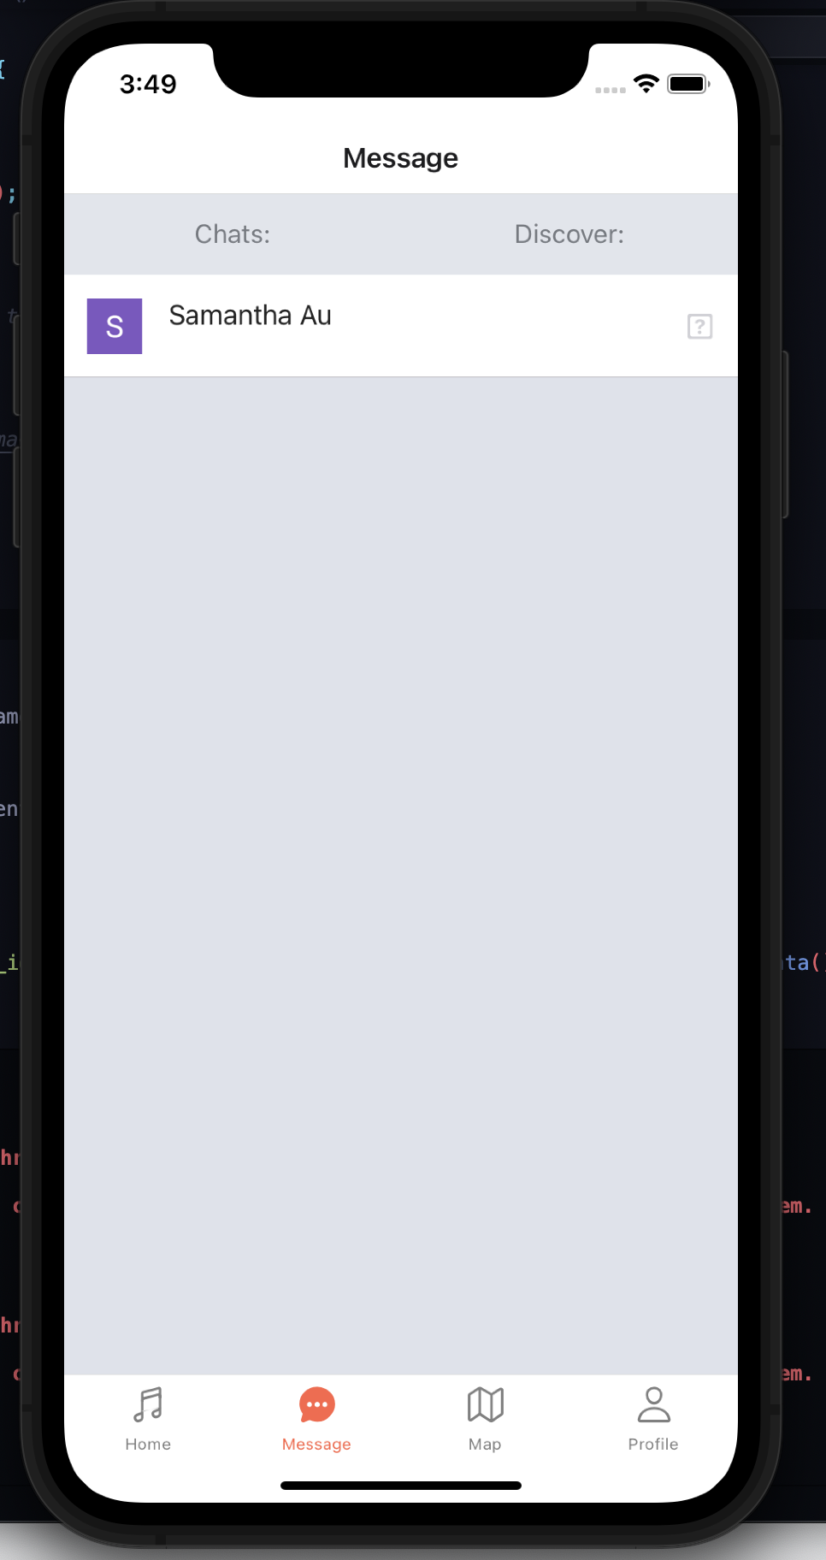
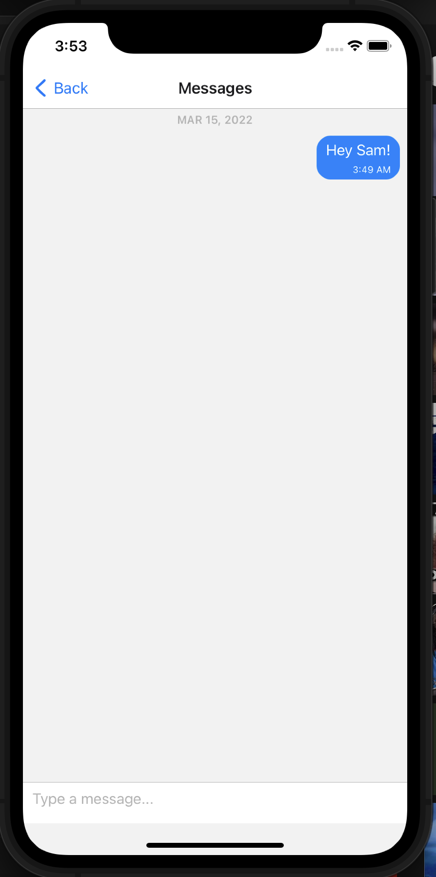
Messaging System

Slide 15
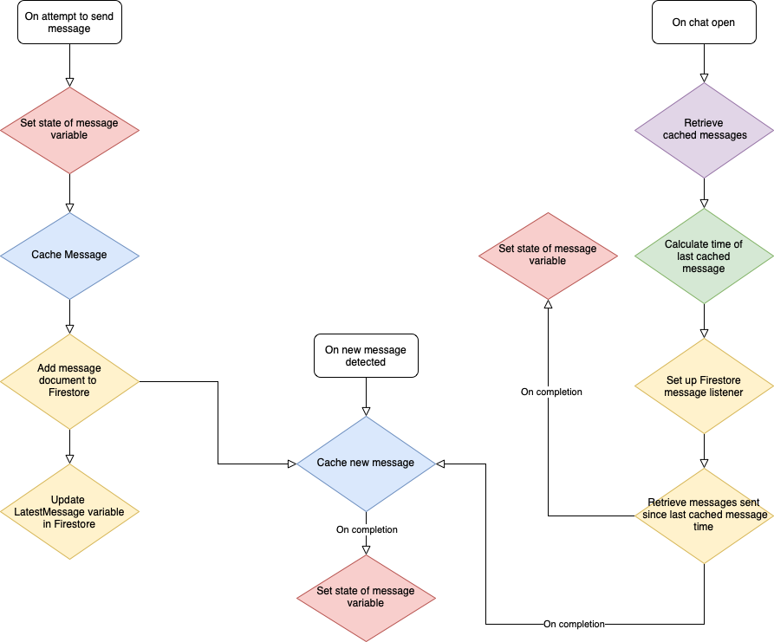
Messaging System - Old
Issues:
Race conditions lead to same message being cached on send and on message received
Message array set using setState() twice in same function call after the completion of an asynchronous task. Also set using setState() after send

Slide 16
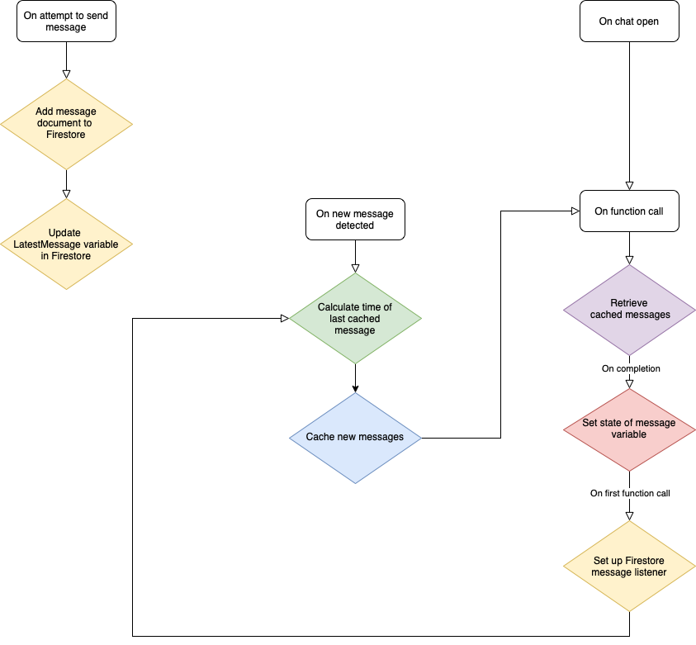
Messaging System- New
Solution:
Do not cache on message send
Refactor some code to another function that is responsible for retrieving and displaying cached messages. Call this function whenever a new message is detected

Slide 17
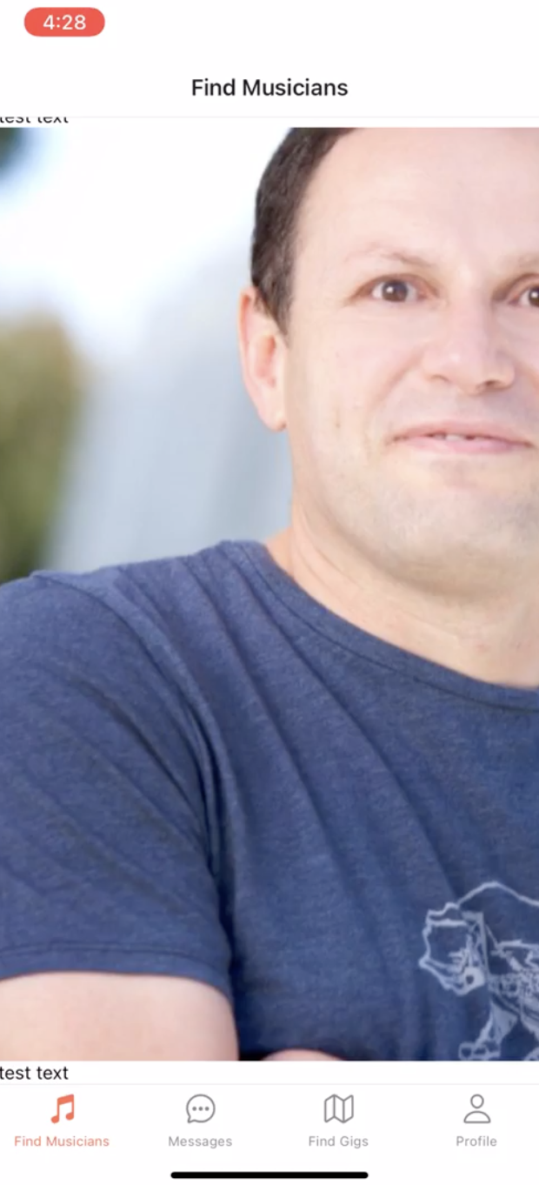
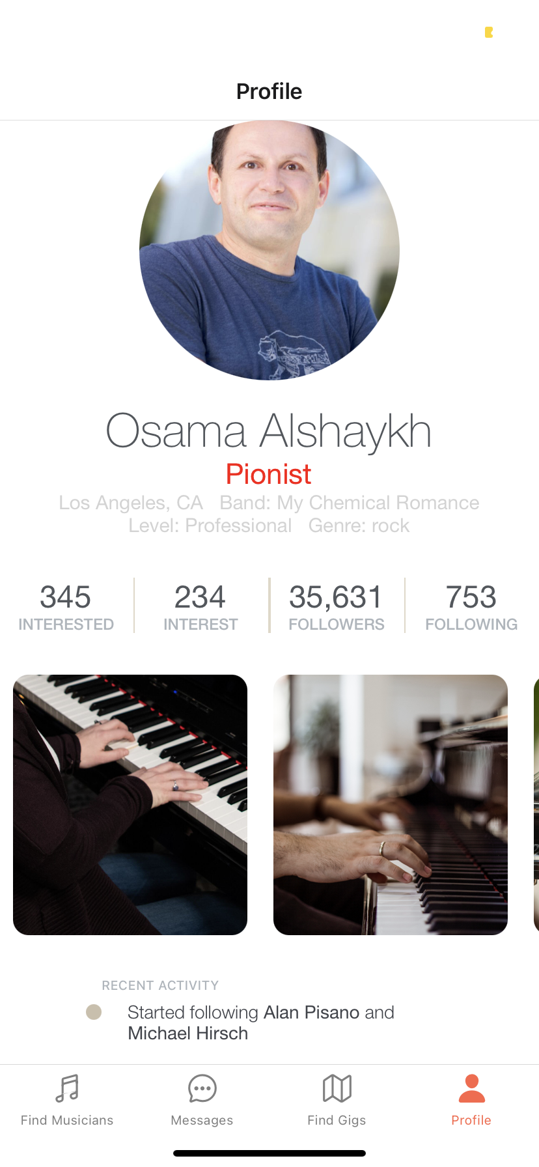
User-Interface (original)
Home Screen
Profile Screen
compiled in ReactNative with Expo - allow cross-platform framework, features reusable components, and includes hot reload feature
Issues?
Formatting with image and text in home page
Profile not linked to user’s information in profile page
Lack of easy access to logout

Slide 18
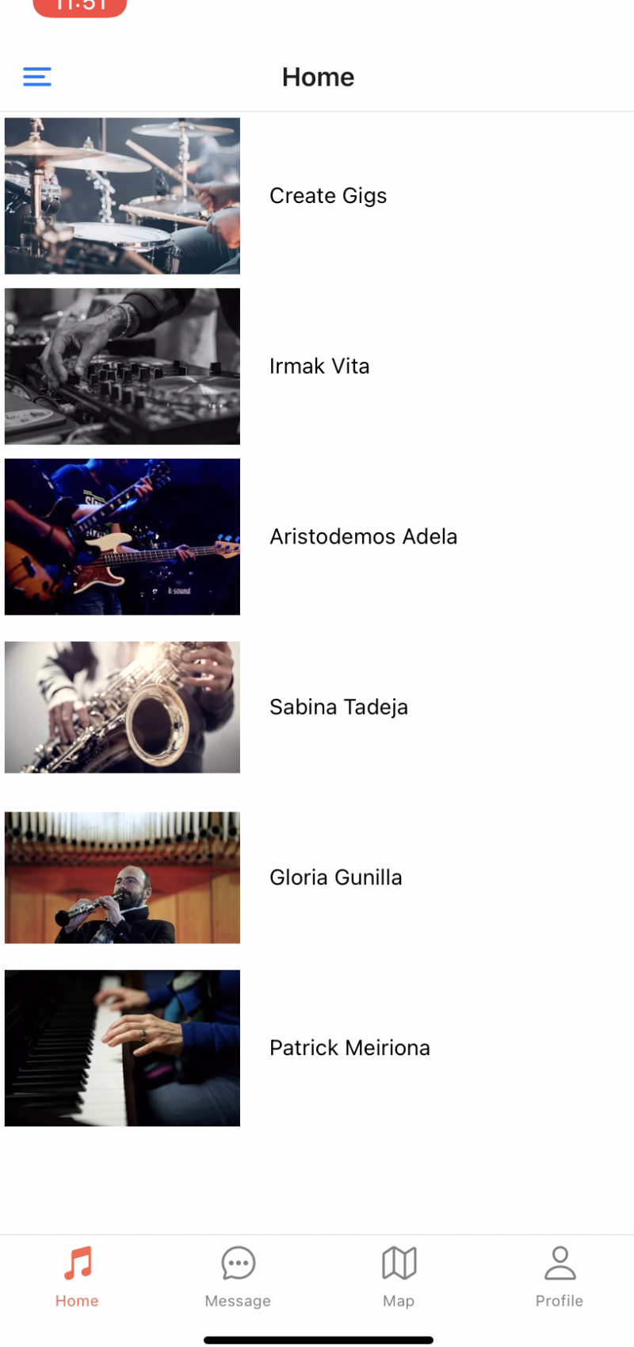
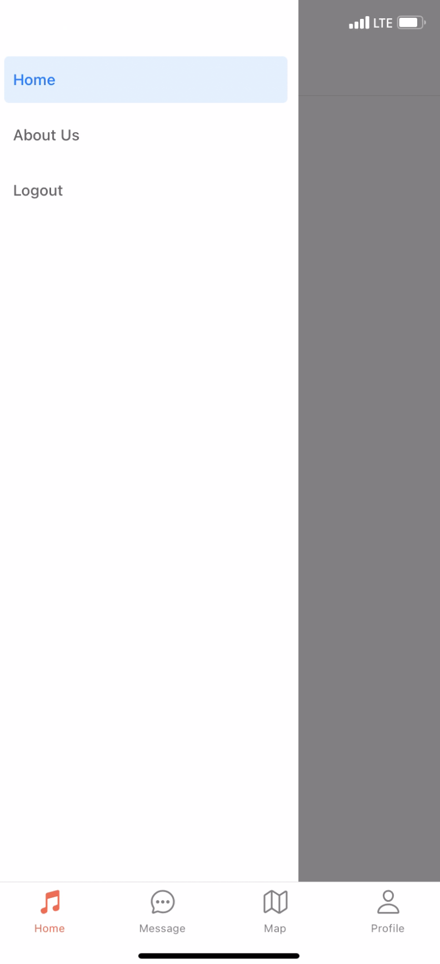
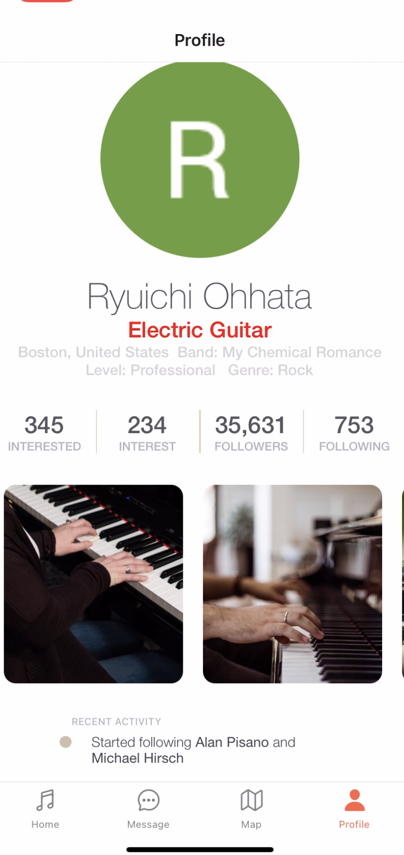
User-Interface (updated)
Home Screen
Side Bar (new)
Profile Screen

Slide 19
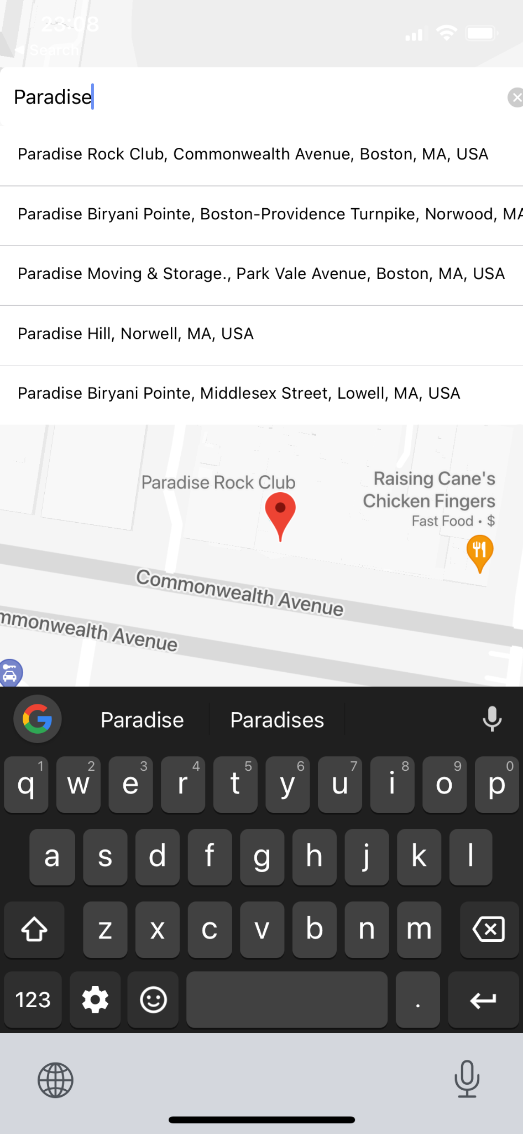
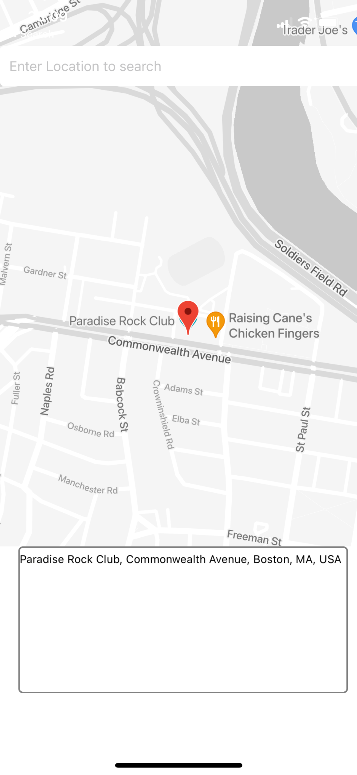
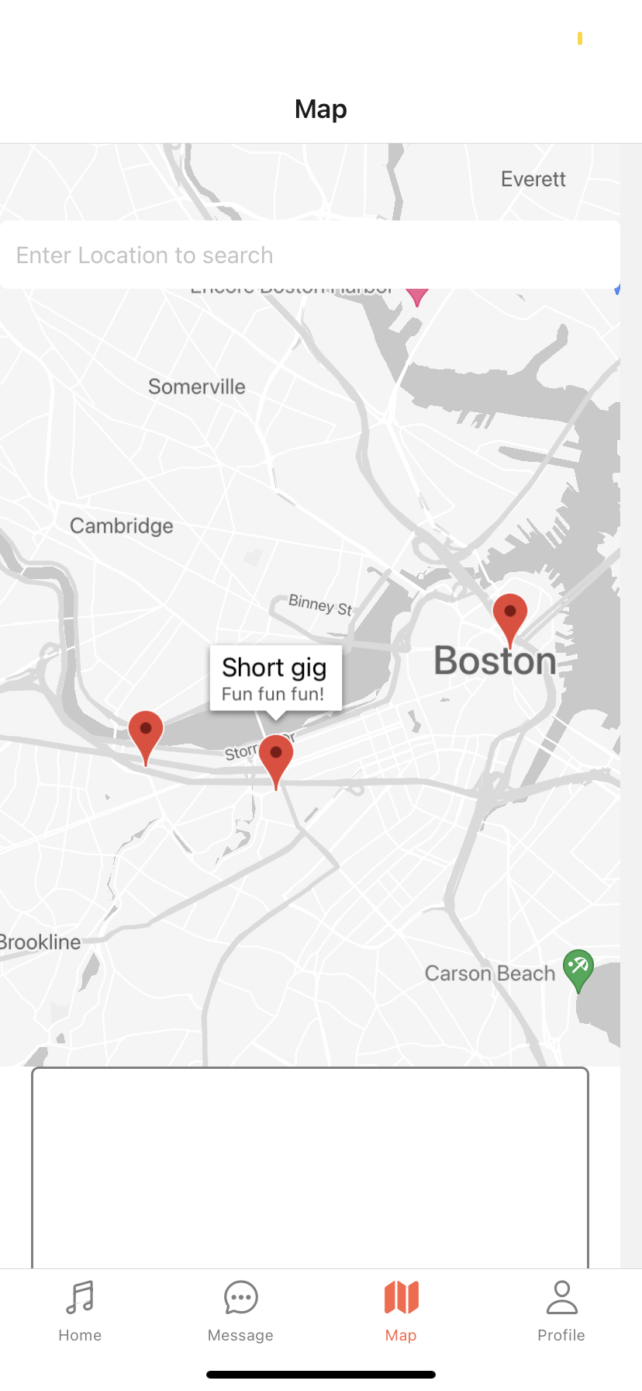
Map Feature

Slide 20
04
Work to be Done

Slide 21
Key Next Steps
Increased Tethers to Database - Certain features are yet to be fully integrated with the existing database system
Robust Testing - Certain screens trigger warnings, hunting down the reasoning behind them would help solidify the app
Kafka Incorporation - Apache Kafka will be utilized for stream processing, enabling notifications
Secure Backend - Our application should secure user credentials and data, subject to pen-tests

Slide 22
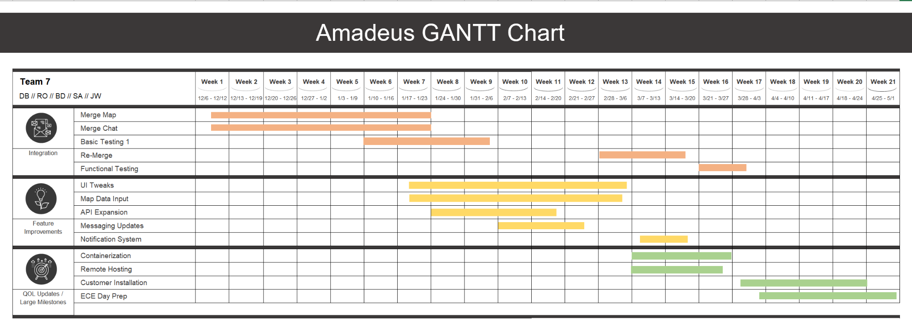

Slide 23
Thank You For Watching

